Slide 1

Leading Incremental and Transformation Change! KWL
Richard DeLorenzo
Sberbank, Russia

Slide 2
Please share your thoughts here
Link is here: bit.ly/2DnOjNU

Slide 3
“The ultimate goal of change is when people see themselves as shareholders with a stake in the success of the system as whole” Michael Fullan
Richard DeLorenzo
Sberbank, Russia

Slide 4


Clock Activity A tool that allows people to network with others
Draw a clock on a sheet of paper
Label 12,3,6,9 o’clock
Set up appointments with your colleagues

Slide 5



Slide 6
Essential Questions
What are the 3 levels of change?
What are your values that will drive the change?
What are the key characteristics of leading incremental leadership?
What are the key characteristics of 2nd order change leadership?
What are your first steps?
Richard DeLorenzo
Sberbank, Russia
Notes:
Comprehension Vocabulary Literary Analysis GenreWord Analysis / Recognition(fluency)
Research and Information Organization (organization, planning) Planning Drafting and Revising(ideas, content, word choice) Genre (sentence fluency) Audience and Purpose (voice, style) Publishing Language Structure (grammar, linguistics, syntax, fluency) Conventions / Editing(punctuation, capitalization) Word Analysis (spelling, word families)

Slide 7
Give examples of all three types of change
----THINK - PAIR- SHARE----
THINK- On your own, consider the question silently.
PAIR- Turn to a partner, each of you explain your thoughts.
SHARE- Volunteer to share out with the group.
Richard DeLorenzo
Sberbank, Russia

Slide 8
What are the 3 levels of change?
1st order change is where you improve the existing system incrementally (minor) and you can easily reverse the changes
2nd order change is creating a new paradigm that can’t be reversed, but can lead to extraordinary results
3rd order change is where you have scaled 2nd order change to impact a cultural shift in society
Richard DeLorenzo
Sberbank, Russia
Notes:
Comprehension Vocabulary Literary Analysis GenreWord Analysis / Recognition(fluency)
Research and Information Organization (organization, planning) Planning Drafting and Revising(ideas, content, word choice) Genre (sentence fluency) Audience and Purpose (voice, style) Publishing Language Structure (grammar, linguistics, syntax, fluency) Conventions / Editing(punctuation, capitalization) Word Analysis (spelling, word families)

Slide 9

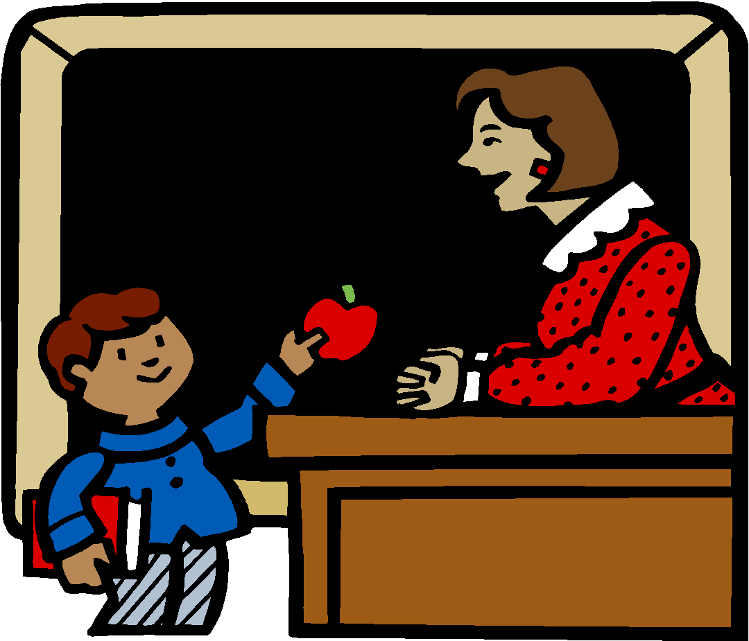

Factors Influencing Achievement
1. Guaranteed and Viable Curriculum 2. Challenging Goals and Effective Feedback 3. Parent and Community Involvement 4. Safe and Orderly Environment 5. Collegiality and Professionalism
School
6. Instructional Strategies
7. Classroom Management
8. Classroom Curriculum Design
Teacher
9. Home Environment
10. Learning Intelligence/ Background Knowledge
11. Motivation
Student
Notes:
Five Whys

Slide 10

Richard DeLorenzo
Sberbank, Russia

Slide 11
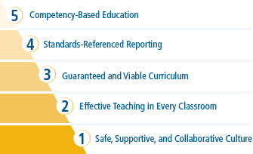
Richard DeLorenzo
Sberbank, Russia

Slide 12

Richard DeLorenzo
Sberbank, Russia

Slide 13
What are the 3 levels of change?
What are your values that will drive the change?
What are the key characteristics of traditional leadership?
What are the key characteristics of 2nd order change leadership?
What are your first steps?
Richard DeLorenzo
Sberbank, Russia
Notes:
Comprehension Vocabulary Literary Analysis GenreWord Analysis / Recognition(fluency)
Research and Information Organization (organization, planning) Planning Drafting and Revising(ideas, content, word choice) Genre (sentence fluency) Audience and Purpose (voice, style) Publishing Language Structure (grammar, linguistics, syntax, fluency) Conventions / Editing(punctuation, capitalization) Word Analysis (spelling, word families)

Slide 14
”I believe every child has an unique destiny and our jobs is to provide all the conditions to help them find their purpose and path in life”
Richard DeLorenzo
Sberbank, Russia

Slide 15
I believe every child learns at a different rate and need to show proficiency to move forward
I believe every child needs to be deeply engaged in their learning
Richard DeLorenzo
Sberbank, Russia

Slide 16
I believe learning needs to be transparent and available 24/7
I believe that every child learns differently and when ready can control their trajectory
Richard DeLorenzo
Sberbank, Russia

Slide 17
What are the 3 levels of change?
What are your values that will drive the change?
What are the key characteristics of traditional leadership?
What are the key characteristics of 2nd order change leadership?
What are your first steps?
Richard DeLorenzo
Sberbank, Russia
Notes:
Comprehension Vocabulary Literary Analysis GenreWord Analysis / Recognition(fluency)
Research and Information Organization (organization, planning) Planning Drafting and Revising(ideas, content, word choice) Genre (sentence fluency) Audience and Purpose (voice, style) Publishing Language Structure (grammar, linguistics, syntax, fluency) Conventions / Editing(punctuation, capitalization) Word Analysis (spelling, word families)

Slide 18
Clock Activity A tool that allows people to network with others
Draw a clock on a sheet of paper
Label 1-12 o’clock
Set up appointments with your colleagues

Slide 20
What are your strengths and challenges in incremental change?
----THINK - PAIR- SHARE----
THINK- On your own, consider the question silently.
PAIR- Turn to a partner, each of you explain your thoughts.
SHARE- Volunteer to share out with the group.
Richard DeLorenzo
Sberbank, Russia

Slide 21
Leadership for incremental change
Emphasize relationships
Establish strong lines of communication
Be an advocate for the school
Provide resources
Maintain visibility
Protect teachers from distractions
Create culture of collaboration
Look for and celebrate successes
Richard DeLorenzo
Sberbank, Russia
Notes:
RISC Overview Video

Slide 22
Continuum of Collegiality (derived from Judith Warren-Little)
Aiding &
Assisting
Joint
Work
“Ostrich”
Scanning &
Storytelling
True
Sharing
Undermines collegiality
Leadership Role in collegiality
Richard DeLorenzo
Sberbank, Russia

Slide 23
4 Critical Questions 1st Order Change
What do we want all students to know and be able to do?
How will we know if they learn it?
How will we respond when some students do not learn?
How will we extend the learning for students who are already proficient?
Richard DeLorenzo
Sberbank, Russia

Slide 24
What are the 3 levels of change?
What are your values that will drive the change?
What are the key characteristics of traditional leadership?
What are the key characteristics of 2nd order change leadership?
What are your first steps?
Richard DeLorenzo
Sberbank, Russia
Notes:
Comprehension Vocabulary Literary Analysis GenreWord Analysis / Recognition(fluency)
Research and Information Organization (organization, planning) Planning Drafting and Revising(ideas, content, word choice) Genre (sentence fluency) Audience and Purpose (voice, style) Publishing Language Structure (grammar, linguistics, syntax, fluency) Conventions / Editing(punctuation, capitalization) Word Analysis (spelling, word families)

Slide 25
What is the one big thing that you would like to see changed in schools?
----THINK - PAIR- SHARE----
THINK- On your own, consider the question silently.
PAIR- Turn to a partner, each of you explain your thoughts.
SHARE- Volunteer to share out with the group.
Richard DeLorenzo
Sberbank, Russia

Slide 26
Leadership for second order change
Shake up the status quo
Expect some things to seem worse
Propose new ideas
Operate from strong shared beliefs
Embrace ambiguity and dissent
Implement research and theory
Create explicit goals for change
Define success in terms of goals
Richard DeLorenzo
Sberbank, Russia

Slide 27
4 Critical Questions 2nd Order Change
Is our system designed to help all children reach their full potential?
What are the current barriers in our schools preventing this?
Are there any models out there we can learn from?
If needed, what are the critical changes we need to make?
Richard DeLorenzo
Sberbank, Russia

Slide 28
What are the 3 levels of change?
What are your values that will drive the change?
What are the key characteristics of traditional leadership?
What are the key characteristics of 2nd order change leadership?
What are your first steps?
Richard DeLorenzo
Sberbank, Russia
Notes:
Comprehension Vocabulary Literary Analysis GenreWord Analysis / Recognition(fluency)
Research and Information Organization (organization, planning) Planning Drafting and Revising(ideas, content, word choice) Genre (sentence fluency) Audience and Purpose (voice, style) Publishing Language Structure (grammar, linguistics, syntax, fluency) Conventions / Editing(punctuation, capitalization) Word Analysis (spelling, word families)

Slide 29
Everyone is a leader because everyone influences someone. Not everyone will become a great leader, but everyone can become a better leader.
Student Bering Strait School District

Slide 30
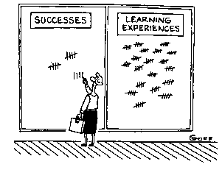

Slide 31
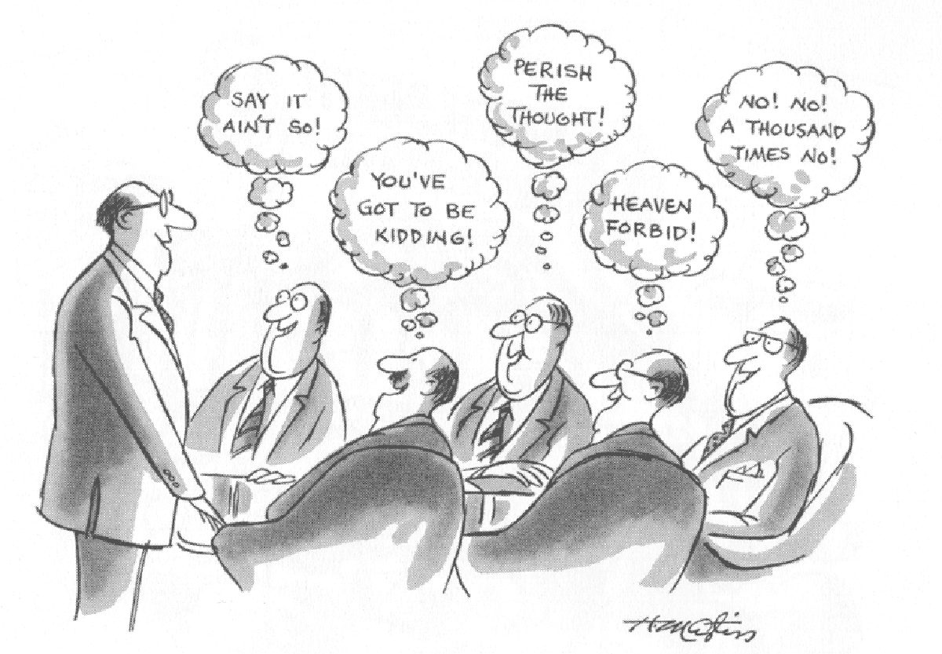
“Aye.”
“All those in favor say ‘Aye.’ ”
“Aye.”
“Aye.”
“Aye.”
“Aye.”

Slide 32
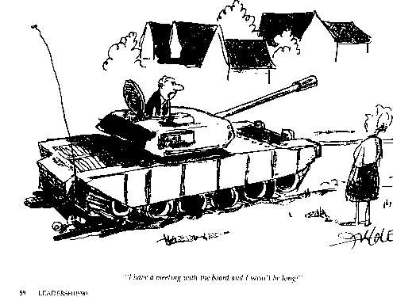
I will show them why I am the leader!

Slide 33
Richard DeLorenzo
Sberbank, Russia

Slide 34
Managing Effective Change
Leader
Shared
Vision
Strategic
Plan
Right
People
CIM
+
+
+
+
=
Utopia
Shared
Vision
Strategic
Plan
Right
People
CIM
=
Happy
Hour
+
+
+
+
Leader
Strategic
Plan
Right
People
CIM
=
Lone
Ranger
+
+
+
+
Leader
Shared
Vision
Right
People
CIM
+
+
+
+
Lost in Space
Leader
Shared
Vision
Strategic
Plan
CIM
=
Poor Results
+
+
+
+
Leader
Shared
Vision
Strategic
Plan
Right
People
Stuck Elevator
+
+
+
+
=
Richard DeLorenzo
Sberbank, Russia

