Slide 1

Delivering on the Promise
“Scaling 2nd order change (DPPS) in a system that has not changed in 150 years”
Richard DeLorenzo
Sberbank, Russia
Notes:
79% will have a deeper discussion about what this means to you
10% will be excited and actually spend time investigating the promise for your system
1% will be doing the heavy work 1 year from now to really change your system class, school or district

Slide 2

Delivering on the Promise
Notes:
Winning the Malcolm Baldrige Award Hanging up on the Sec. My mother, family dumpster diving.

Slide 3
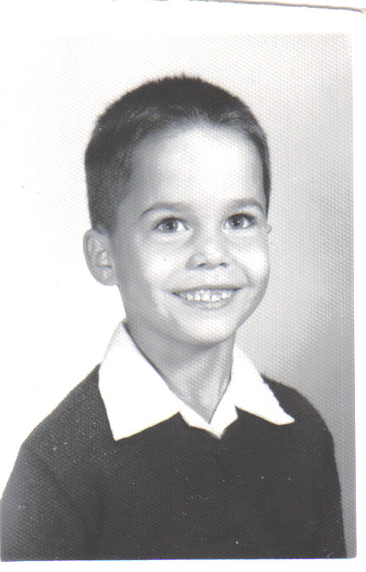
Richard DeLorenzo
Sberbank, Russia

Slide 4
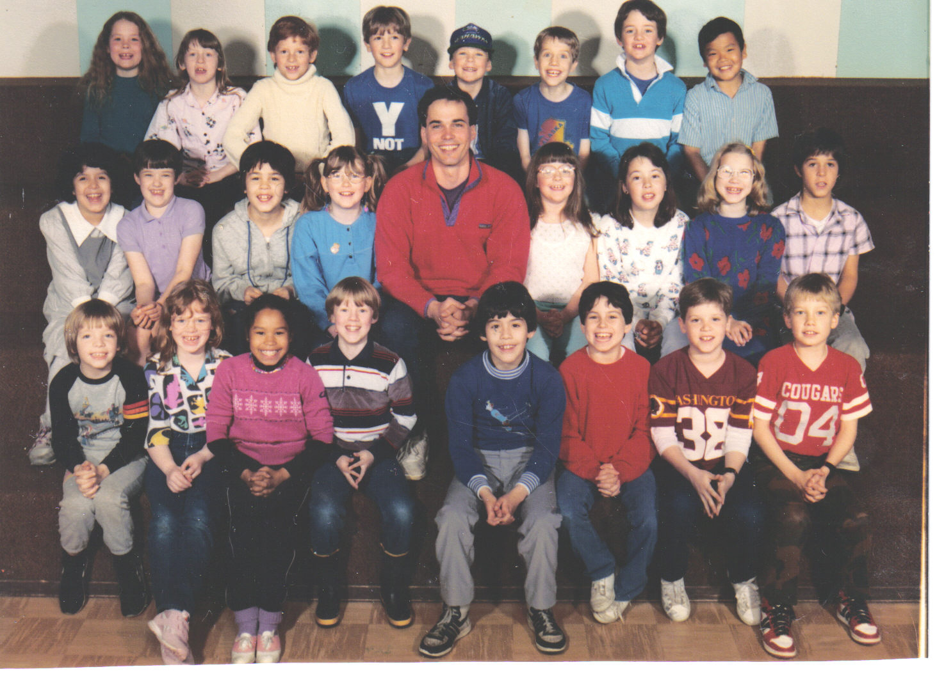

Slide 5
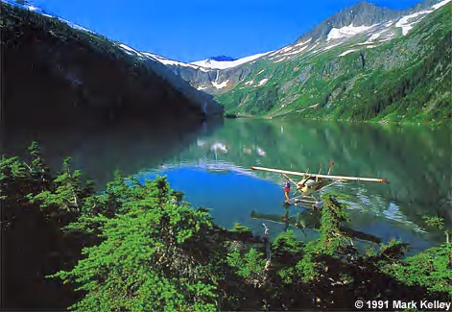

Slide 6
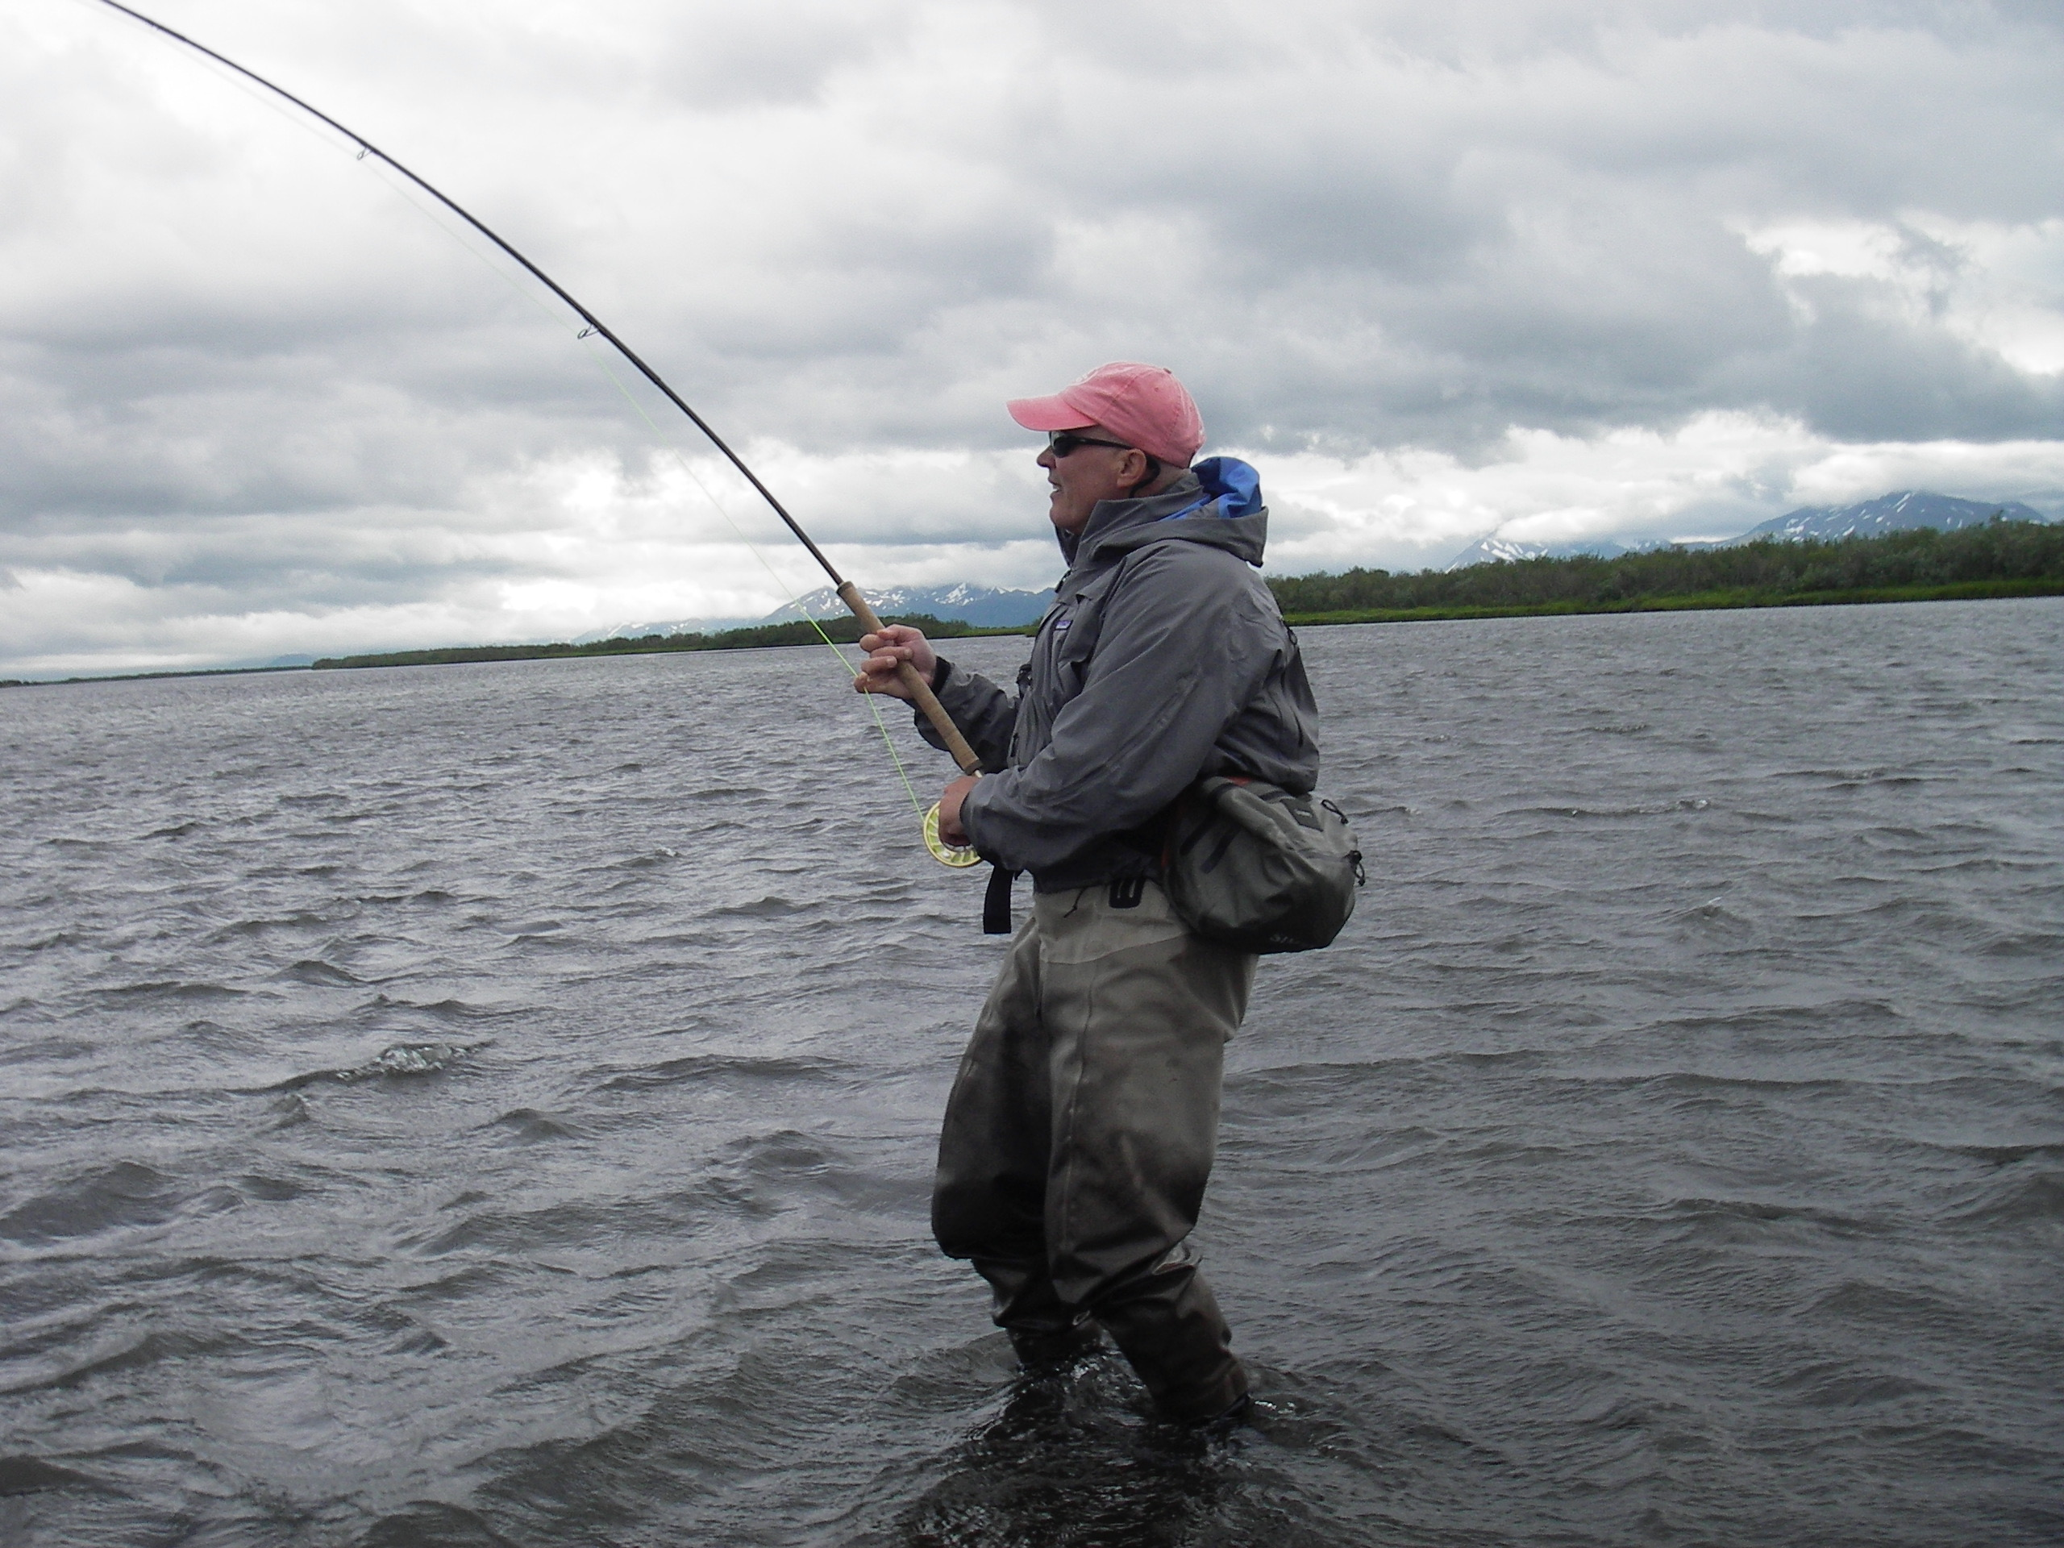

Slide 7
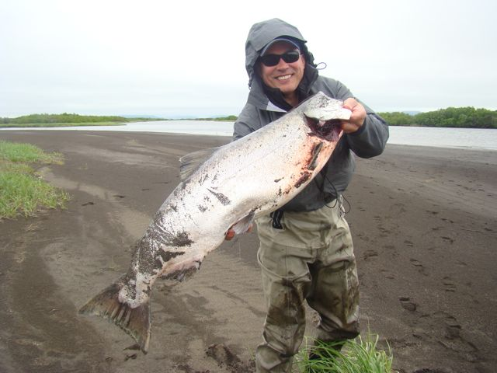

Slide 8
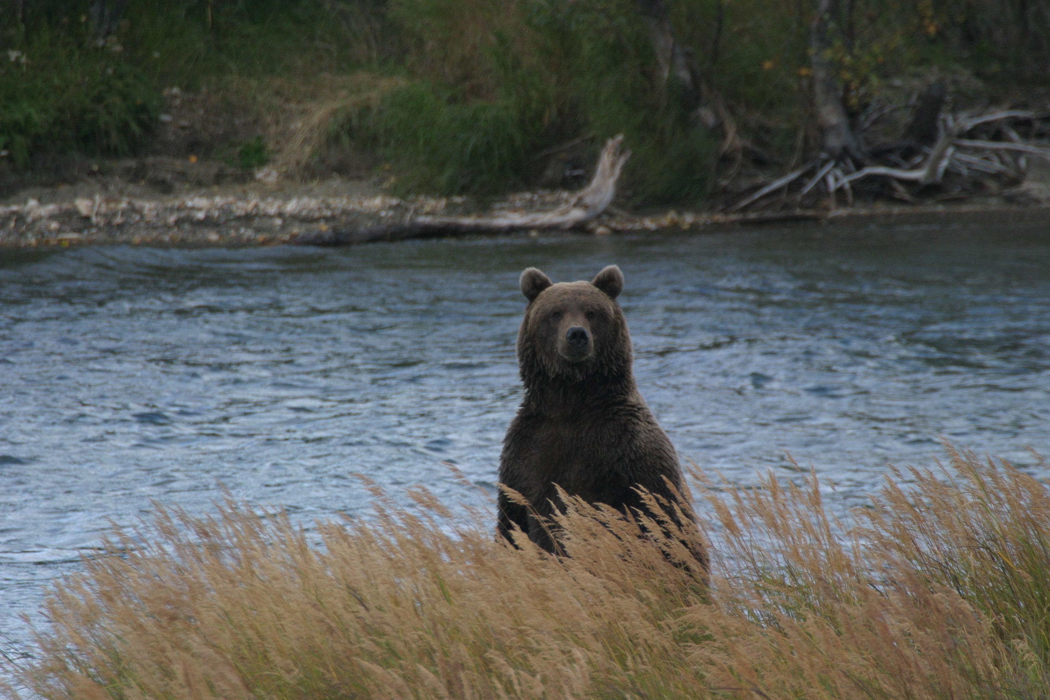

Slide 9
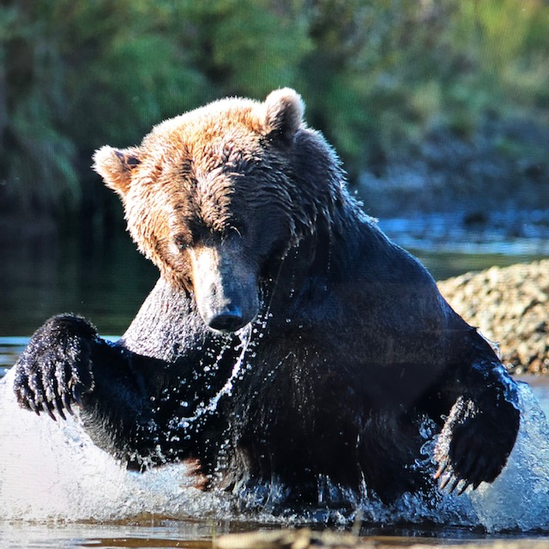

Slide 10
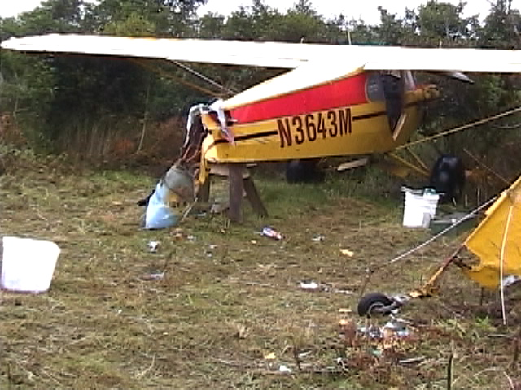

Slide 11
Essential Questions
----THINK - PAIR- SHARE----
THINK- On your own, consider the question silently.
PAIR- Turn to a partner, each of you explain your thoughts.
SHARE- Volunteer to share out what your partner has said with the group.
Richard DeLorenzo
Sberbank, Russia

Slide 12
Why does our educational system need to change?
What are the beliefs that drive this change?
How is this digital personal mastery system different from the traditional one?
What are the first steps?
Richard DeLorenzo
Sberbank, Russia

Slide 13
Why does our educational system need to change?
What are the beliefs that drive this change?
How is this digital personal mastery system different from the traditional one?
What are the first steps?
Richard DeLorenzo
Sberbank, Russia

Slide 14
Quick Historical Overview
Schooling for some
Schooling for all
Learning for some
Learning for all (equity)
Learning for all within a growth mindset to be life long learners (equity and quality)
Richard DeLorenzo
Sberbank, Russia

Slide 15
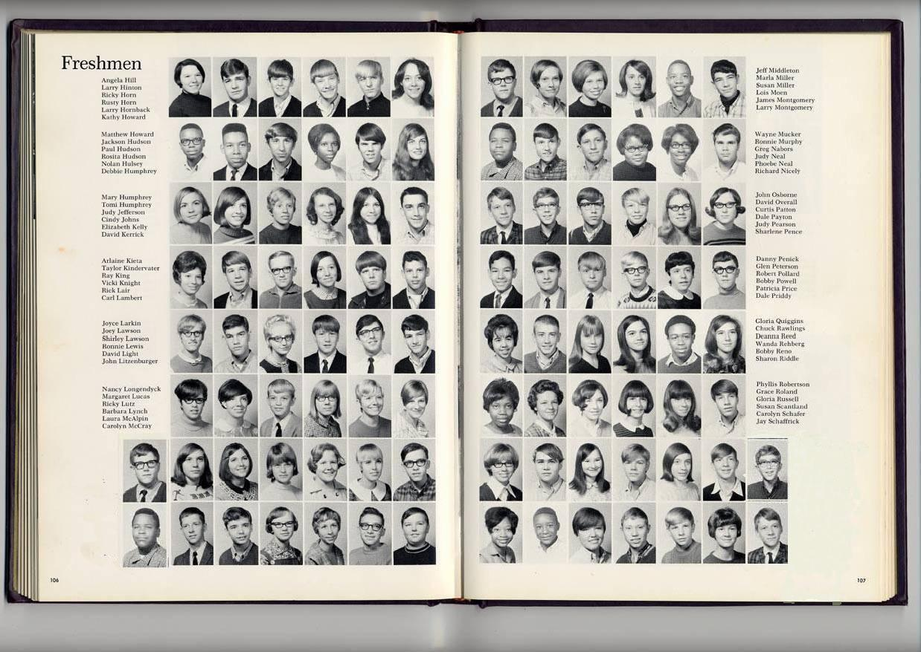
Out of every 100 ninth graders….
Richard DeLorenzo
Sberbank, Russia

Slide 16
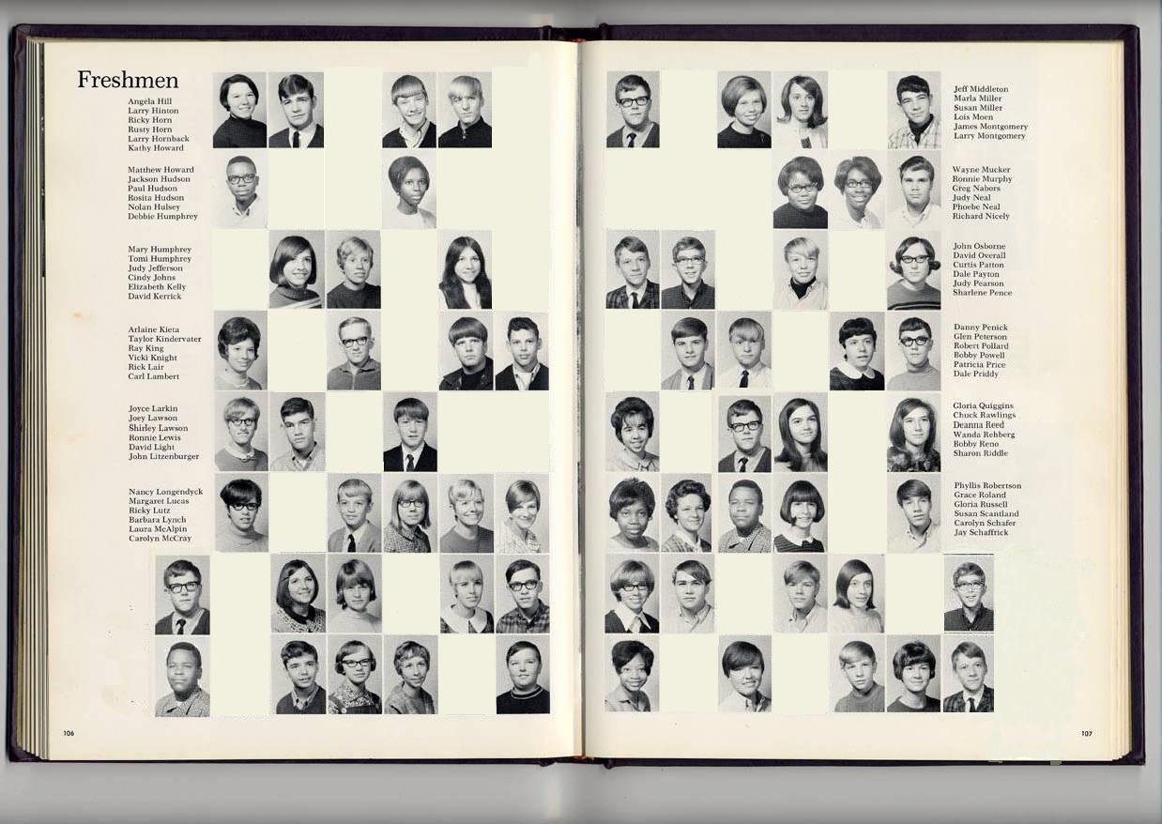
…65 will graduate from high school…
Richard DeLorenzo
Sberbank, Russia

Slide 17
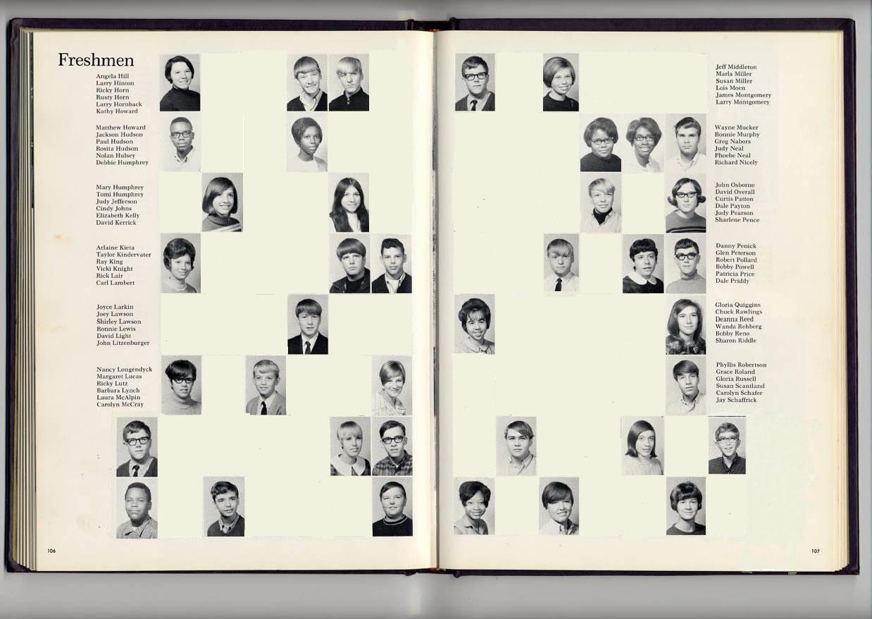
…39 will enter college…
Richard DeLorenzo
Sberbank, Russia

Slide 18
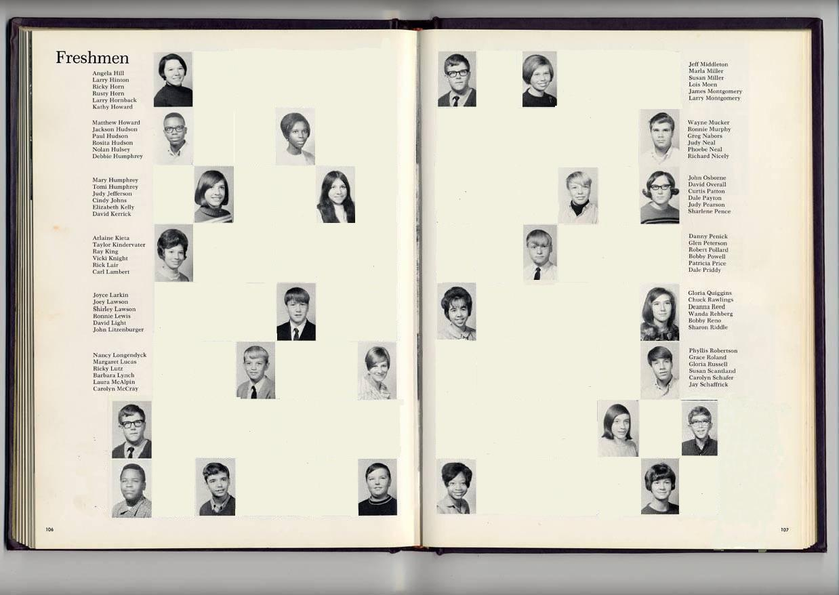
…26 are still enrolled in the sophomore year…
Richard DeLorenzo
Sberbank, Russia

Slide 19
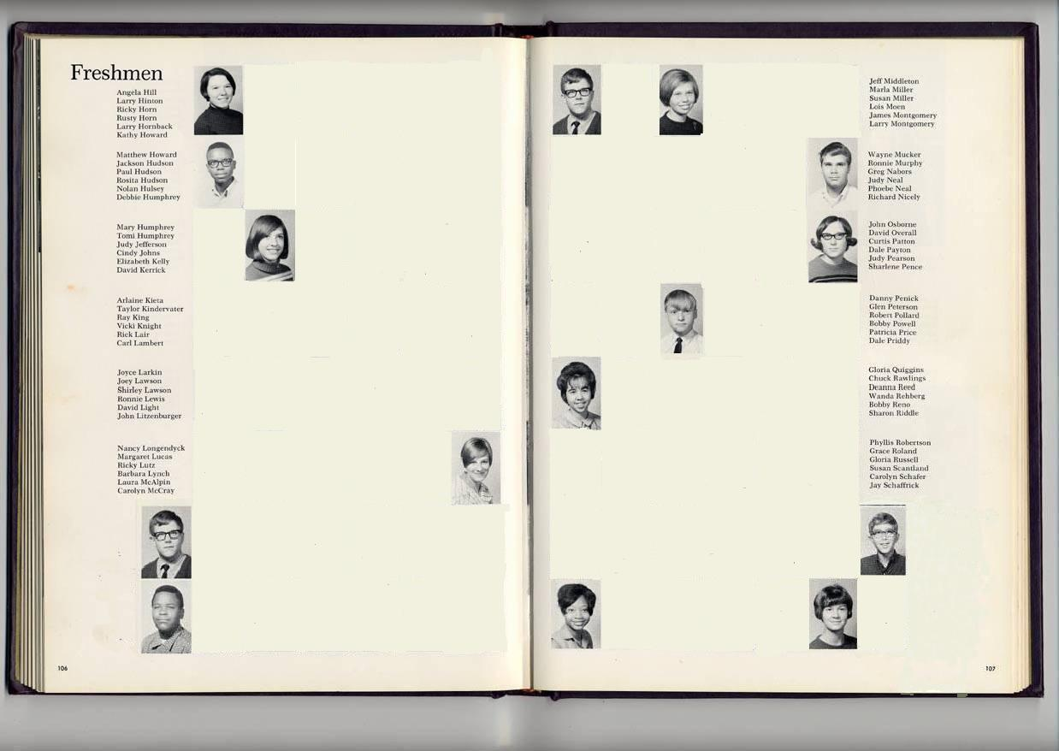
…15 will graduate from college
Richard DeLorenzo
Sberbank, Russia

Slide 20
Learning for some
1,000 students will drop out during my presentation!
20,000 during our conference!
Richard DeLorenzo
Sberbank, Russia

Slide 21
21st Century Projections from Daniel Pink
21st Century Skills Conceptual Age (creators and innovators)
Information Age (knowledge workers)
Industrial Age
(factory workers)
Agricultural
Age (farmers)
18th Century
19th Century
20th Century
21st Century
Notes:
Copper

Slide 22
Why does our educational system need to change?
What are the beliefs that drive this change?
How is this digital personal proficiency system(DPPS) different from the traditional one?
What are the first steps?
Richard DeLorenzo
Sberbank, Russia

Slide 23
”I believe every child has an unique destiny, driven by their beliefs and values and our jobs is to provide all the conditions to help them find their purpose and path in life and help them embrace a growth mindset”
Richard DeLorenzo
Sberbank, Russia

Slide 24
Evolution of the Learner
Traditional | Future
Little input from learners
Predetermined pace of learning
Teacher-centered
Textbook driven
Teach to the middle of the class
Hard copy of learning materials
Notes:
Needs to be translated

Slide 25
Evolution of the Learner
Traditional | Future
Little input from learners | Voice and choice
Predetermined pace of learning | Self-directed, acceleration of learning
Teacher-centered | Child-centered
Textbook driven | Results driven by outcomes
Teach to the middle of the class | Meeting individual needs
Hard copy of learning materials | Digital learning platform
Notes:
Needs to be translated

Slide 26
Evolution of a Teacher
Traditional | Future
Directive, Authoritarian
Knowledge transferred by teachers
All teachers get same training
Teachers work in isolation
Assessment through traditional paper-pencil testing
Knowledge seen as fixed
Limited career pathway

Slide 27
Evolution of a Teacher
Traditional | Future
Directive, Authoritarian | Partners with learners
Knowledge transferred by teachers | Knowledge is created with the learner
All teachers get same training | Personalized professional development linked to teacher competencies
Teachers work in isolation | Teachers work in collaborative groups
Assessment through traditional paper-pencil testing | Assessments through self-assessments, performance tasks & interdisciplinary projects
Knowledge seen as fixed | Knowledge seen as dynamic
Limited career pathway | Multiple life pathways

Slide 28
Evolution of Curriculum and Assessments
Traditional | Future
Advancement based on fixed periods of time
Curriculum based on historical norms
Stagnant curriculum
Vague and hidden from the learner
Curriculum based on age of learner
Little flexibility
Assessments are of summative nature and high stakes

Slide 29
Evolution of Curriculum and Assessments
Traditional | Future
Advancement based on fixed periods of time | Advancement based on demonstrated mastery
Curriculum based on historical norms | Curriculum based on learner’s future
Stagnant curriculum | Dynamic curriculum including 21st century skills
Vague and hidden from the learner | Transparent to all stakeholders
Curriculum based on age of learner | Curriculum based on readiness of learning
Little flexibility | Focused on the needs of the learner
Assessments are of summative nature | Formative assessments are dominant in the system

Slide 30
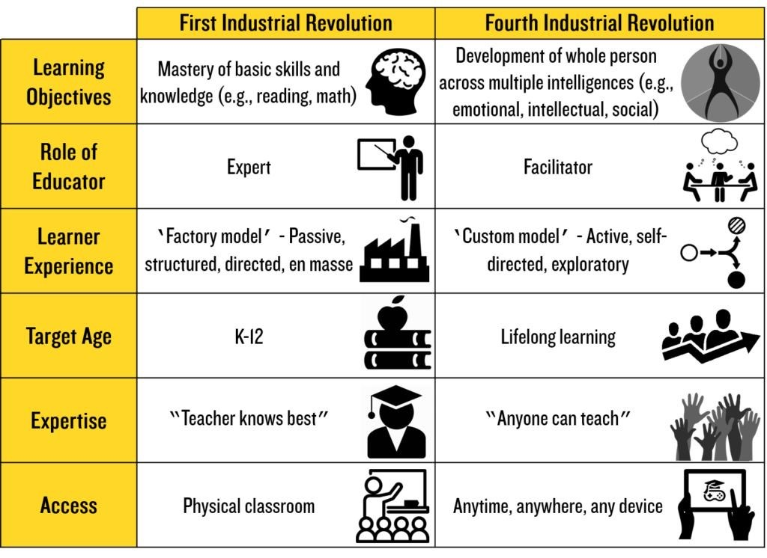

Slide 31

The Key Difference…
This Digital Personal Proficiency Learning(DPPL) approach to schools
is where the entire educational system prepares students for their future, by engaging students in 21st century skills‚ in a
learner-centered environment,
working at their instructional levels and advancing only when they have demonstrated proficiency.
The RISC approach to learning
is where the entire educational system is organized around engaging students in 21st century skills‚ in a
learner-centered environment,
working at their developmental levels and advancing only when they have demonstrated proficiency.
Richard DeLorenzo
Sberbank, Russia

Slide 32
LIED Utvalget; their mandate, The questions they will attempt to address are the following:
Is secondary education in Norway organized in a way that ensures that every student has a chance to succeed?
Is today’s model satisfactory in meeting the requirements of tomorrow's job market and providing the new skills that are required?
Does the current model promote a desire to learn and make it motivating to learn for all our students?
Are we meeting every student at their current level and helping them achieve their goals?

Slide 33
To meet these goals the conclusion they arrive at would have to look like this:
We make sure every student can advance when they are ready
We allow students to advance in the program when they can, and spend more time when they need to.
That they will be able to choose the topics that interest them without having to choose from a set structure
That the way students in Norway do exam will change so that the goals listed above are possible, as is the situation today.

Slide 34
Why does our educational system need to change?
What are the beliefs that drive this change?
How is this digital personal proficiency learning system different from the traditional one?
What are the first steps?
Richard DeLorenzo
Sberbank, Russia

Slide 35
Lindsay Video
----THINK - PAIR- SHARE----
THINK- How does the role of the student, teacher, parent and administration change?
PAIR- Turn to a partner and share your thoughts.
SHARE- Volunteer to share out.
Richard DeLorenzo
Sberbank, Russia

Slide 36
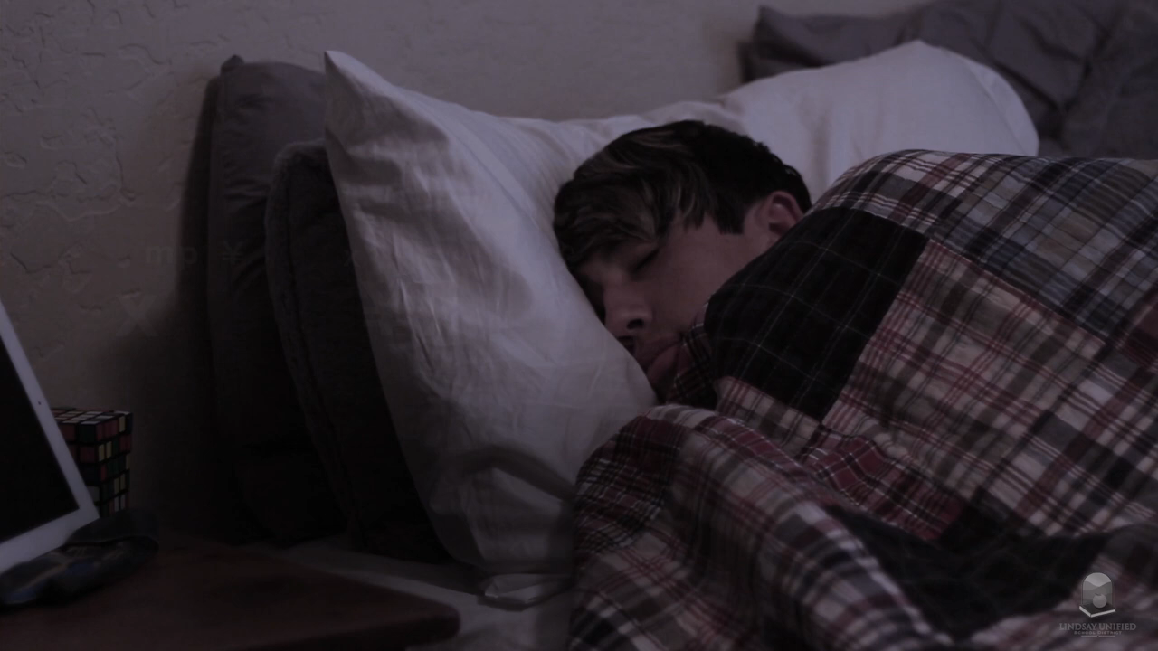

Slide 37
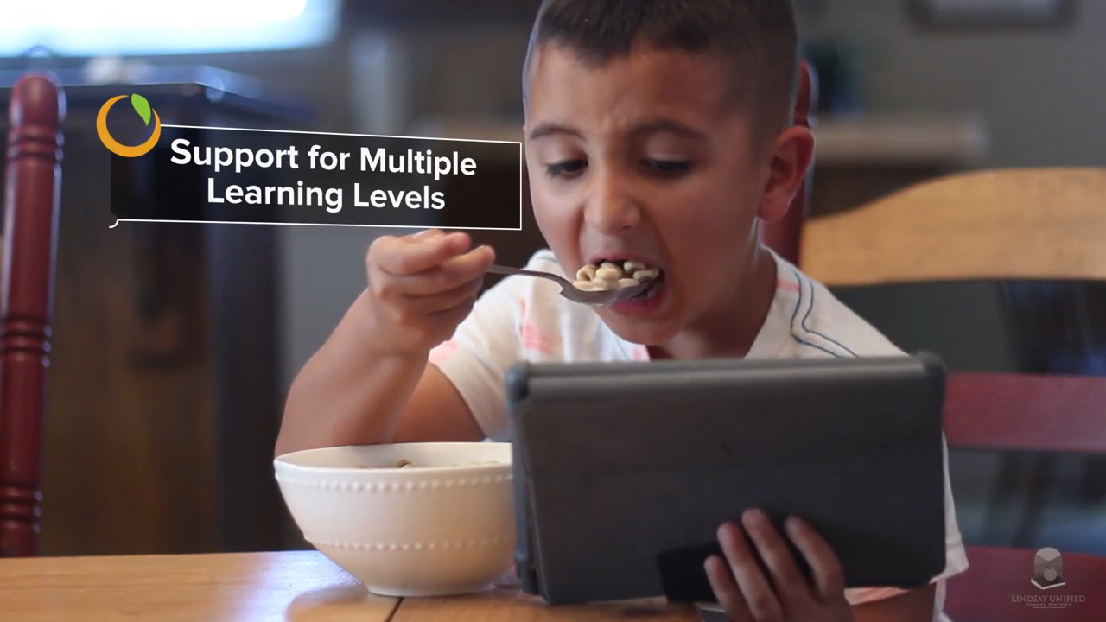

Slide 38
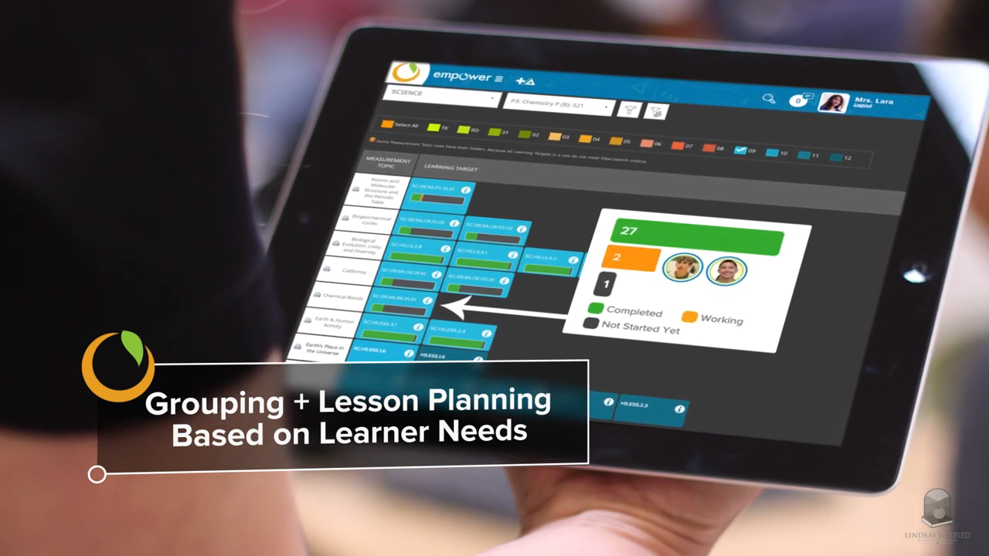

Slide 39
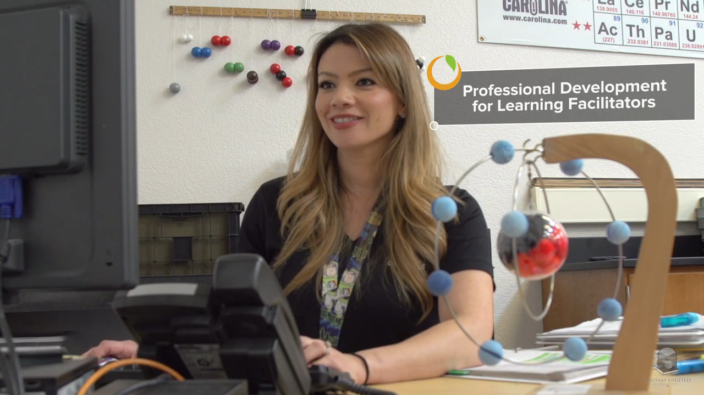

Slide 40
Change is never easy, especially in a system that has been in place for over 150 years and we will defend it even if we know it doesn’t work because it is all we know.
Richard DeLorenzo
Sberbank, Russia

Slide 41
Why does our educational system need to change?
What are the beliefs that drive this change?
How is this digital personal mastery system different from the traditional one?
What are the first steps?
Richard DeLorenzo
Sberbank, Russia

Slide 42
“Change Forces with a Vengeance”
New Horizons for System Change
1st Order
Large-scale improvement of literacy and numeracy that is not sustainable
2nd Order
System change that results in unleashing energy, commitment, resources and learning on a very large scale to accomplish things never done before that is sustainable
Richard DeLorenzo
Sberbank, Russia

Slide 43
Richard DeLorenzo
Sberbank, Russia

Slide 44
Where can I see this in action?
https://www.lindsay.k12.ca.us
https://www.westminsterpublicschools.org
http://www.collegiateacademy.co.uk/shireland/
Richard DeLorenzo
Sberbank, Russia

Slide 45
The Russian leaders pointed to the mountain and wanted me to show teachers that it could be moved!
Richard DeLorenzo
Sberbank, Russia

Slide 46
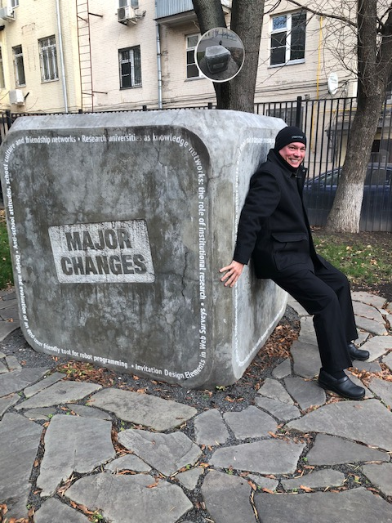
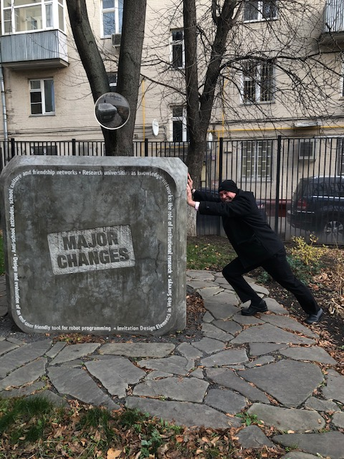

Slide 47
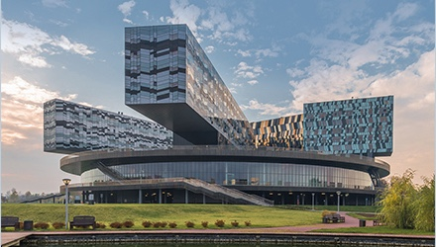

Slide 48
DPPS in Russia 1,000 schools in 3 years
Richard DeLorenzo
Sberbank, Russia

Slide 49
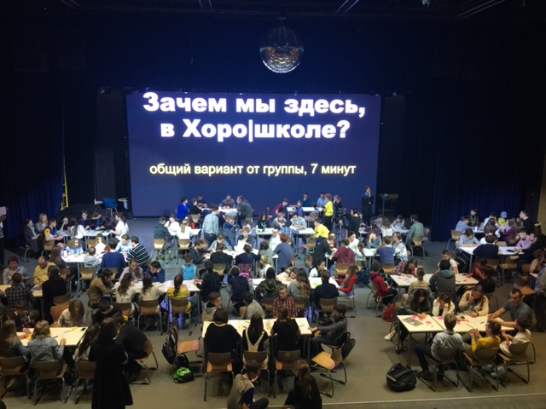

Slide 50
Why does our educational system need to change?
What are the beliefs that drive this change?
How is this digital personal mastery system different from the traditional one?
What are the first steps?
Richard DeLorenzo
Sberbank, Russia

Slide 51
CRIS
What was one “aha” and what is a question I can answer?
Clarify: the question or topic
Reflect: individually
Impact: on you and your system
Share: your thoughts
Richard DeLorenzo
Sberbank, Russia

Slide 52
“This system provides a clear road map of what students need to know and do in each content area. Besides mastery of basic skills, the needs of the whole child are considered including character development, career development, service learning, and technology. All the skills we need to be successful in the 21st century.”
Baldrige acceptance speech
by Nathaniel Moore
Chugach School District student

Slide 53
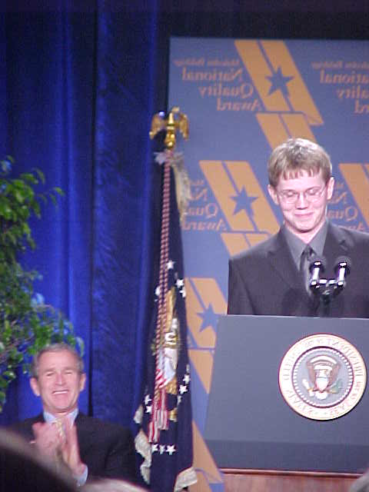
“Delivering on the Promise”
Nathaniel Moore Acceptance Speech 2001 Baldrige Award Celebration
Richard DeLorenzo
Sberbank, Russia
Notes:
You now have two choices
10% will do something extraordinary

