Slide 1


TEST QUESTION 1: FUTURE NUMBER OF CHILDREN
Q1.1
?
How many children will there be in 2100?
In 1950 there were fewer than one billion children (aged 0-14) in the world. By 2000 there were almost two billion. How many do UN experts think there will be in 2100?
Billion Children
4
A
4 billion
A
3
B
3 billion
B
2
C
2 billion
1
0
1950
2000
2050
2100
Source: http://esa.un.org/unpd/wpp/unpp/panel_indicators.htm
www.gapminder.org/teach
Free teaching material for a fact-based worldview
Version: 13

Slide 2
TEST QUESTION 1: FUTURE NUMBER OF CHILDREN
Q1.1
How many children will there be in 2100?
In 1950 there were fewer than one billion children (aged 0-14) in the world. By 2000 there were almost two billion. How many do UN experts think there will be in 2100?
CORRECT
ANSWER
Billion Children
4
A
4 billion
A
3
B
3 billion
B
2
C
2 billion
1
0
1950
2000
2050
2100
Source: http://esa.un.org/unpd/wpp/unpp/panel_indicators.htm
www.gapminder.org/teach
Free teaching material for a fact-based worldview
Version: 13

Slide 3


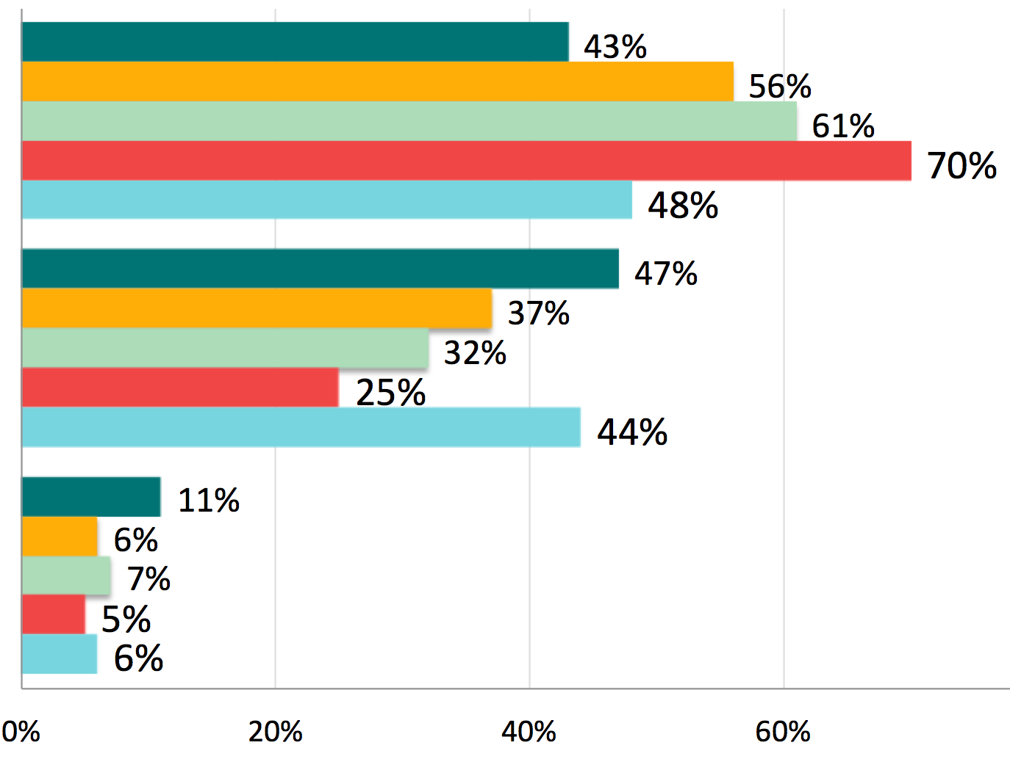
TEST QUESTION 1: FUTURE NUMBER OF CHILDREN
How many children will there be in 2100?
— ANSWERS
A
4 billion
A
B
3 billion
B
C
2 billion

Slide 4
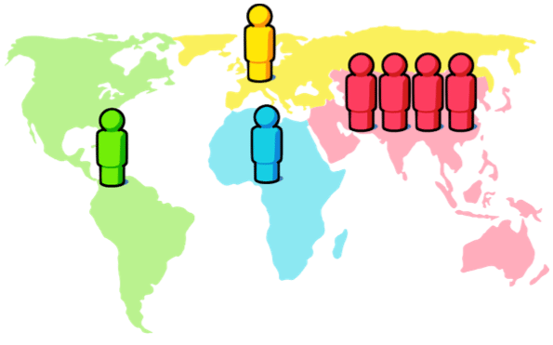
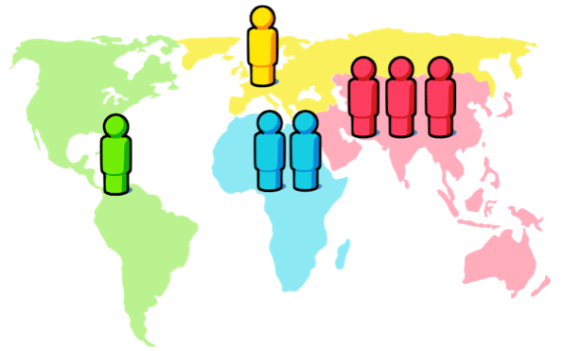

TEST QUESTION 2: WHERE PEOPLE LIVE
Q2.1
?
Where do people live?
There are 7 billion people in the world today. Of the maps below, which one do you think shows best where they live in the Americas, Europe, Africa and Asia?
A
B
B
C
A
www.gapminder.org/teach
Free teaching material for a fact-based worldview
Version: 5

Slide 5
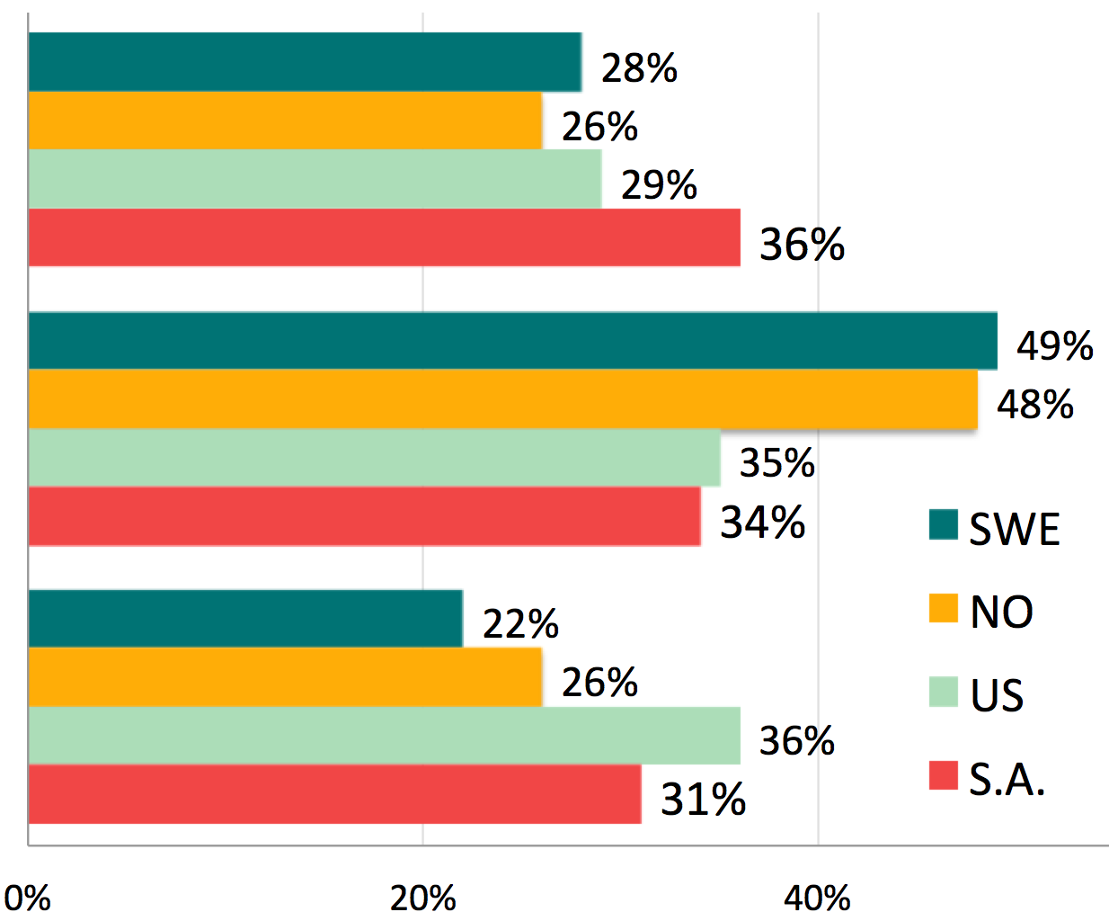
TEST QUESTION 2: WHERE PEOPLE LIVE
Where do people live? — ANSWERS
A
B
B
C

Slide 6
TEST QUESTION 3: WORLD LIFE EXPECTANCY
Q3.1
?
What is the average life expectancy at birth in the world today?
A
50 years
A
B
60 years
A
C
70 years
A
www.gapminder.org/teach
Free teaching material for a fact-based worldview
Version: 5

Slide 7
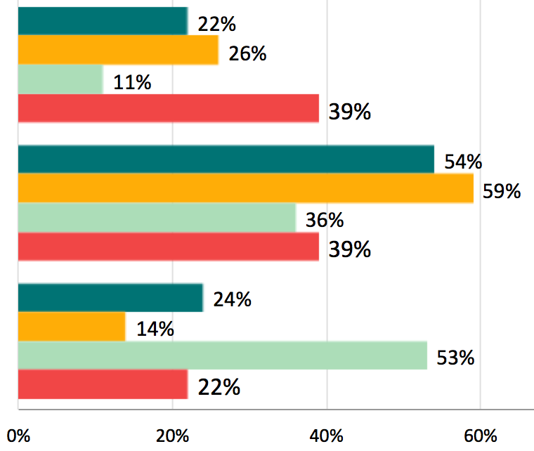
TEST QUESTION 3: WORLD LIFE EXPECTANCY
Q3.1
What is the average life expectancy at birth in the world today? — ANSWERS
A
50 years
A
B
60 years
A
C
70 years
A
Source: http://esa.un.org/unpd/wpp/unpp/panel_indicators.htm
www.gapminder.org/teach
Free teaching material for a fact-based worldview
Version: 5

Slide 8
TEST QUESTION 4: WORLD LITERACY
Q3.1
?
What percentage of adults in the world today are literate — can read and write?
A
80%
A
B
60%
A
C
40%
A
www.gapminder.org/teach
Free teaching material for a fact-based worldview
Version: 5

Slide 9
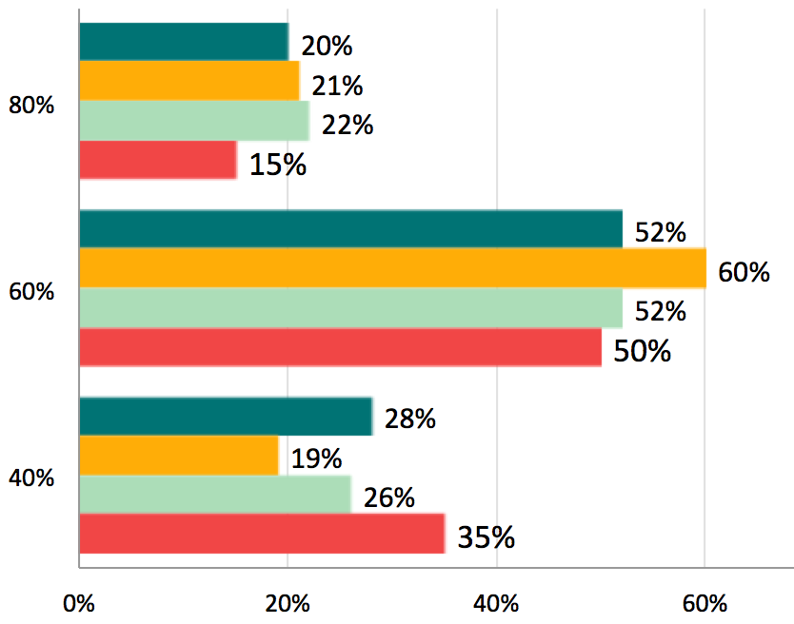

TEST QUESTION 4: WORLD LITERACY
Q3.1
What percentage of adults in the world today are literate — can read and write?
— ANSWERS
A
80%
A
B
60%
A
C
40%
A
www.gapminder.org/teach
Free teaching material for a fact-based worldview
Version: 5

Slide 10
TEST QUESTION 5: WOMEN’S SHOOLING
Q3.1
?
Women’s schooling
Women aged 30 spent how many years in school?
(Men of same age spent 8 years)
A
3 years
A
B
5 years
A
C
7 years
A
www.gapminder.org/teach
Free teaching material for a fact-based worldview
Version: 5

Slide 11
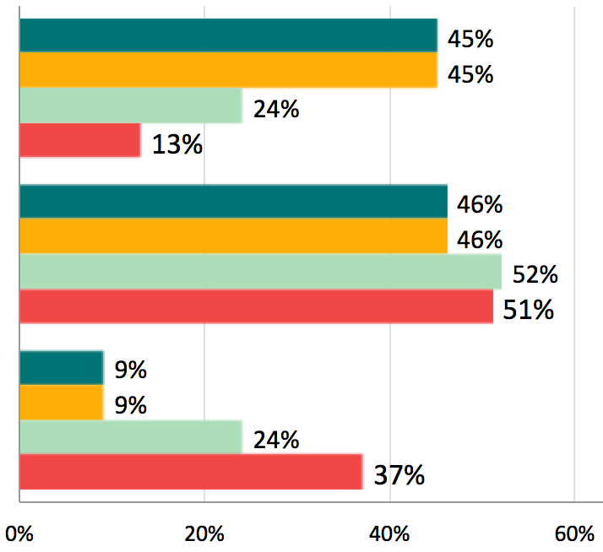
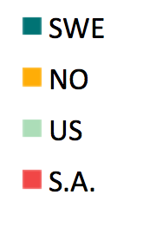
TEST QUESTION 5: WOMEN’S SHOOLING
Q5.1
Women’s schooling
Women aged 30 spent how many years in school?
(Men of same age spent 8 years)
ANSWERS
A
3 years
A
B
5 years
A
C
7 years
A
www.gapminder.org/teach
Free teaching material for a fact-based worldview
Version: 1

Slide 12
TEST QUESTION 6: VACCINATION COVERAGE
Q6.1
?
Vaccination Coverage
What percentage of the world’s one-year old children is vaccinated against measles?
A
20%
A
B
50%
A
C
80%
A
www.gapminder.org/teach
Free teaching material for a fact-based worldview
Version: 1

Slide 13
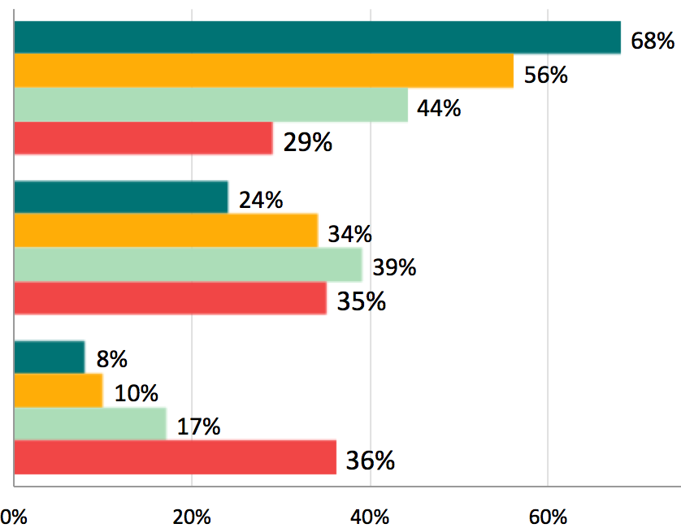

TEST QUESTION 6: VACCINATION COVERAGE
Q6.1
Vaccination Coverage — ANSWERS
What percentage of the world’s one-year old children is vaccinated against measles?
ANSWERS
A
20%
A
B
50%
A
C
80%
A
www.gapminder.org/teach
Free teaching material for a fact-based worldview
Version: 1

Slide 14
TEST QUESTION 7: EXTREME POVERTY RATE TREND
Q7.1
?
Extreme Poverty Rate Trend
In the last 20 years the proportion of the World population living in extreme poverty has...
A
Almost doubled
A
B
Remained more or less the same
A
C
Almost halved
A
www.gapminder.org/teach
Free teaching material for a fact-based worldview
Version: 1

Slide 15
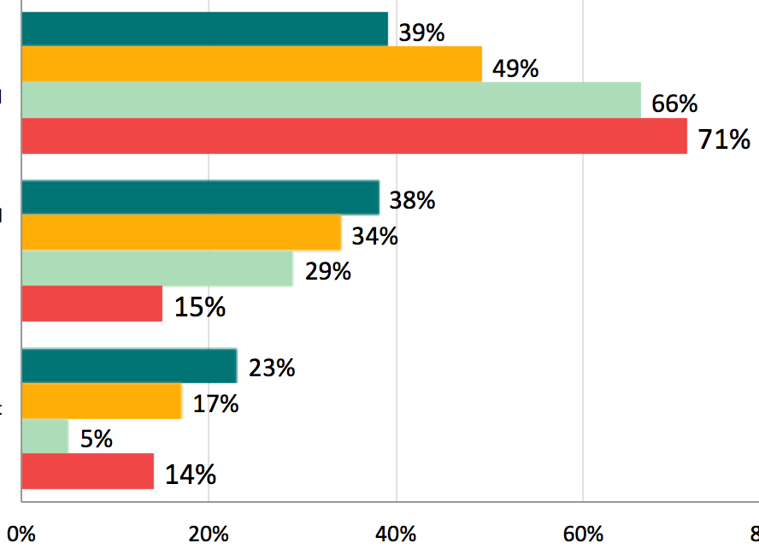
TEST QUESTION 7: EXTREME POVERTY RATE TREND
Q7.1
Extreme Poverty Rate Trend — ANSWERS
In the last 20 years the proportion of the World population living in extreme poverty has...
A
Almost doubled
A
Remained more
or less the same
B
A
C
Almost halved
A
www.gapminder.org/teach
Free teaching material for a fact-based worldview
Version: 1

Slide 16
TEST QUESTION 8: DISASTERS DEATHS TREND
Q8.1
?
Disasters Deaths Trend
How did the number of deaths per year from natural disasters change over the last hundred years?
A
More than doubled
A
B
Remained about the same
A
C
Decreased to less than half
A
www.gapminder.org/teach
Free teaching material for a fact-based worldview
Version: 1

Slide 17
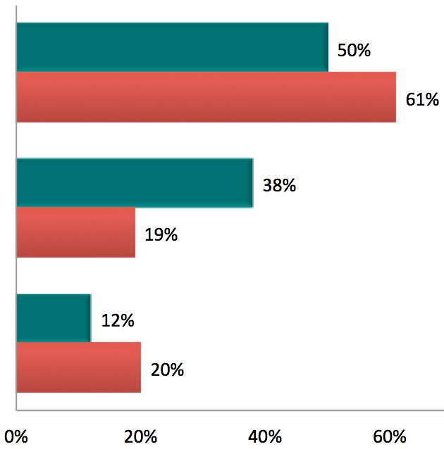
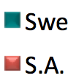
TEST QUESTION 7: EXTREME POVERTY RATE TREND
Q7.1
Extreme Poverty Rate Trend — ANSWERS
In the last 20 years the proportion of the World population living in extreme poverty has...
More than doubled
A
A
B
Remained about the same
A
C
Decreased to less than half
A
www.gapminder.org/teach
Free teaching material for a fact-based worldview
Version: 1

Slide 18
TEST QUESTION 9: BABIES PER WOMAN
Q9.1
?
Babies per woman
In 1965, the number of babies born per woman in the world, on average, was 5.
What do you think the number is today?
A
4.5
A
B
3.5
A
C
2.5
A
www.gapminder.org/teach
Free teaching material for a fact-based worldview
Version: 1

Slide 19
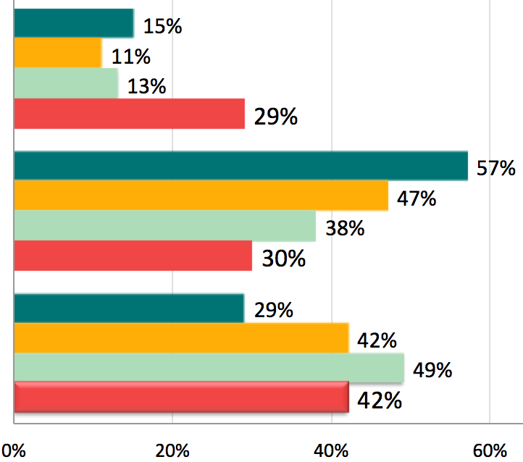
Babies per woman — ANSWERS
A
4.5
A
B
A
3.5
C
A
2.5
www.gapminder.org/teach
Free teaching material for a fact-based worldview
Version: 1

